Slide 1
A Step Towards Smart Ration Card System Using RFID & IOT

Slide 2
Relevance
Ration card is extremely vital for every home. It perform as address evidence for various purposes. It is used for various fields such as for obtaining family members details, to obtain gas connection, etc. Every home has a ration card to obtain the various materials (sugar, rice, oil, kerosene, etc.) from the ration shops.
The proposed automatic ration shop for public distribution framework is based on Smart Automating rationing system that replaces ordinary ration cards. Smart rationing system based on RFID card is a valuable innovation for productive, precise, and auto- mated strategy of proportion conveyance.

Slide 3
Description
The proposed automatic ration shop for public distribution framework is based on Smart Automating rationing system that replaces ordinary ration cards. A fingerprint sensor is used for identification. The proposed distribution framework has the ability to overcome disadvantages of the existing system like wrong amount of products, low processing speed, and large wait in time, material theft in ration shop. The principle goal of the planned framework is the automation of ration shops to give straightforwardness. Main goal of the planned system is the real time authentication of the consumer and automation of material distribution in ration shop. We propose to design a smart rationing system in which the authentication is based on Smart ration card that replaces the present paper based ration card. Here the RFID tag act as smart card which consist of all the details about the card holder like family details, type of card

Slide 4
Description
Customer needs to scan RFID Tag on RFID reader, which is followed by fingerprint scanning and the then microcontroller checks customer’s details with stored to distribute material in ration shop. After successful verification, customers need to enter type of material as well as quantity of material using keypad the material get automatically displayed in LCD display and commodities are dispatched without manual interpretation. Once the commodities are dispensed, the microcontroller sends the information to customer through IoT technology.

Slide 5
Objectives
The project titled smart E-Rationing system propose to develop a system which enable the real time authentication of the consumer and automation of material distribution in ration shop. We propose to design a smart rationing system in which the authentication is based on Smart ration card that replaces the present paper based ration card. Fingerprint module and RFID module is interfaced to the Arduino Microcontroller through serial port. The user scans the smart card, which is then verified using a stored database. It is followed by Fingerprint identification to verify the identity of the user. The fingerprint scanner acts as a level 2 authentication to stop any fraudulent activity.

Slide 6
Objectives
After successful verification customers need to enter type of material and quantity of material using keypad the material get automatically dispatch without manual interpretation. After delivering proper materials to consumer the microcontroller sends information to customers through IoT technology. The customer can also track the history of their past consumption using blynk app. The main objective is to have a completely automated system with no human intervention resulting in 24x7 Operation like ATM Machine, automatic Ration distribution with a mechanized dispensing assembly, corruption and Forged Ration delivery problems minimized to a large extent, Two level online real-time authentication of consumer (RFID based Smart Card, biometric),the consumer database (blynk app) will be updated after each transaction, Once commodities are dispensed the information will be sent to the consumer and the Government authority is alerted in case of theft or malpractice.

Slide 7
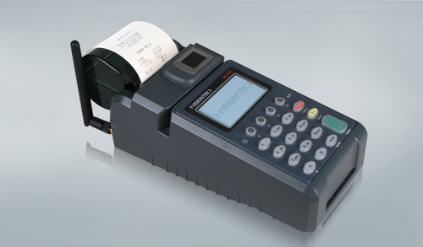
Existing System

Slide 8
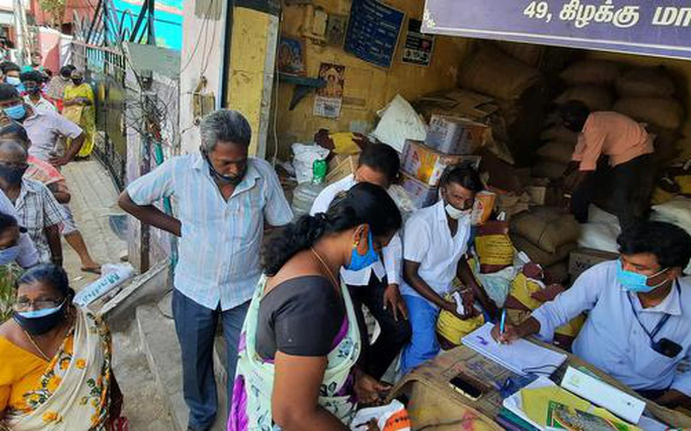
Existing System
ISSUES

Slide 9
Proposed System
The present ration distribution framework has downsides like wrong amount of products, low processing speed, and large wait in time, material theft in ration shop. The pro- posed framework replaces the manual work in proportion shop. The principle goal of the planned framework is the robotization of ration shop to give straightforwardness.
This system helps to maintain the data properly
Increased adulteration in consumables can be prevented
Cost effective approach
Time saving approach
Corruption in the Government and market sector can be prevented by automation

Slide 10
Input/ Output and Modules
ADMIN AUTHENTICATION
USER AUTHENTICATION
DATA VERIFICATION
PRODUCT DISTRIBUTION
UPDATION

Slide 11
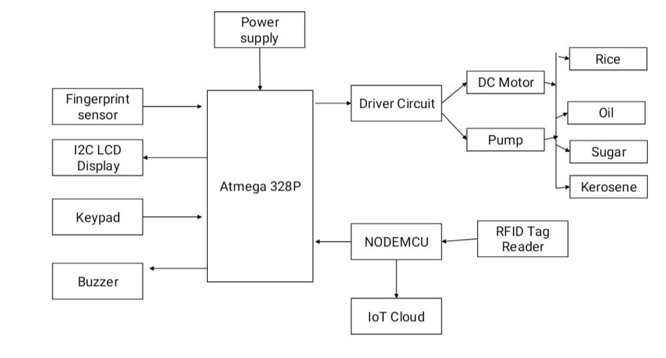
BLOCK DIAGRAM

Slide 12
THANK YOU

